Slide 1
Secure Data Hiding in image using Steganography
CAPSTONE PROJECT
Presented By : Shoury Pandya
Student Name : Shoury Pandya
College Name : AD Patel Institute of Technology, CVM University
Department : B.Tech in Artificial Intelligence and Data Science

Slide 2
OUTLINE
Problem Statement
Technology used
Wow factor
End users
Result
Conclusion
Git-hub Link
Future scope

Slide 3
Problem Statement
Develop a Python-based Image Steganography application to securely hide and retrieve text messages within images.
The program allows users to select an image, encrypt a secret message using pixel manipulation, and save the modified image.
It supports decryption by extracting the hidden message upon entering the correct passcode.
The system ensures data integrity, user-friendly interaction, and secure access to hidden messages via the command line.

Slide 4
Technology used
Programming Language:
Python (Using OpenCV for image processing)
Libraries & APIs:
OpenCV – For image processing and pixel manipulation
NumPy – For data handling and numerical operations
OS Module – For file handling and system operations
Platform Compatibility :
Operating System: Windows, macOS, Linux
Python Version: Python 3.x
Development Environment:
IDE: VS Code, PyCharm, or Jupyter Notebook
Build Tool: No specific build tool required (can use virtual environments if needed)
This setup ensures a cross-platform, lightweight, and user-friendly application for image steganography.

Slide 5
Wow factors
Python-Based CLI (Unlike Java!) – Most image steganography projects use Java for GUI, but this project implements everything in Python using OpenCV, making it lightweight and efficient.
Integrated Image Processing – The program directly manipulates pixel values using OpenCV, ensuring seamless encryption and decryption without external GUI frameworks.
User-Friendly Terminal Interface – Unlike GUI-based tools, this CLI-based system offers simple file selection and status messages, making encryption/decryption straightforward.
Cross-Platform Support – Python ensures seamless execution on Windows, macOS, and Linux, without requiring complex dependencies or heavy installations.
Efficient Encoding Mechanism – Uses RGB pixel manipulation to embed messages without noticeable image distortion, ensuring high security and data integrity.

Slide 6
End users
Cybersecurity Enthusiasts & Researchers – Individuals exploring data hiding techniques and secure communication methods using Python.
Journalists & Whistleblowers – People who need to hide sensitive information inside images for secure transmission without raising suspicion.
Students & Educators – Those learning about steganography, cryptography, and image processing using Python in computer science courses.
Forensic Experts & Law Enforcement – Investigators analyzing hidden messages in digital images for cybercrime detection.
Privacy-Conscious Users – General users who want to securely share messages without traditional encryption methods that might attract attention.
Military – Military personnel involved in covert operations who require secure, concealed communication for exchanging classified information without raising suspicion.

Slide 7
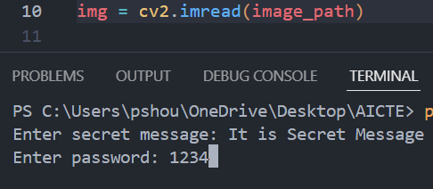
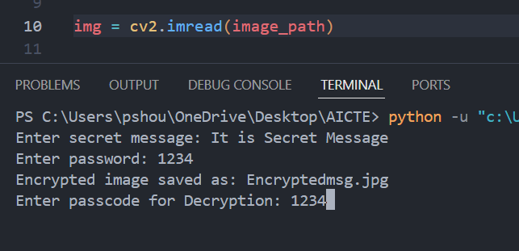
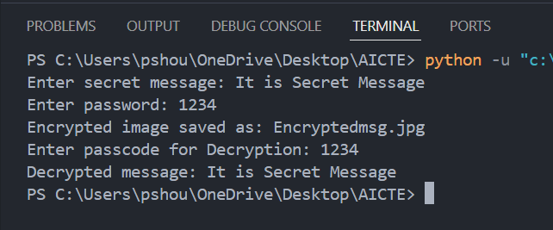
results
1
2
3

Slide 8
Conclusion
This project showcases the use of Python-based image steganography to securely hide and retrieve messages within images. With a easy-direct-terminal support, it provides a simple yet effective solution for secure communication. Whether for cybersecurity experts, military use, or privacy-conscious individuals, this tool ensures that sensitive information remains protected. The integration of image manipulation and encryption principles makes it a valuable asset in real-world security applications.

Slide 9
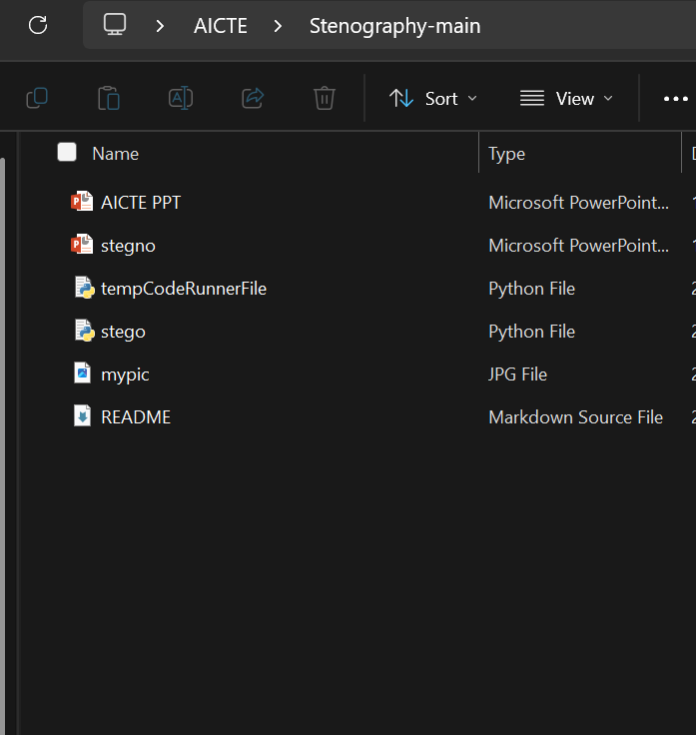
GitHub Link
https://github.com/ShouryPandya/Edunet-Internship.git

Slide 10
Future scope(optional)
Advanced Encryption Techniques – Integrating more sophisticated encryption algorithms like AES or RSA for added security in message encoding and decoding.
Steganography in Video – Expanding the project to embed messages in video files, providing an even more discreet medium for secure communication.
Mobile Application – Developing a mobile version of the tool for Android or iOS to allow users to easily perform steganography directly from their smartphones.
File Type Support – Enhancing the tool to support a wider range of file formats, such as PNG, BMP, or TIFF, for greater flexibility.
Watermarking Integration – Incorporating digital watermarking techniques for both image security and copyright protection in sensitive content.
Real-time Messaging – Allowing real-time encryption and decryption of messages exchanged through live video or streaming platforms.

Slide 11
THANK YOU

